Slide 1
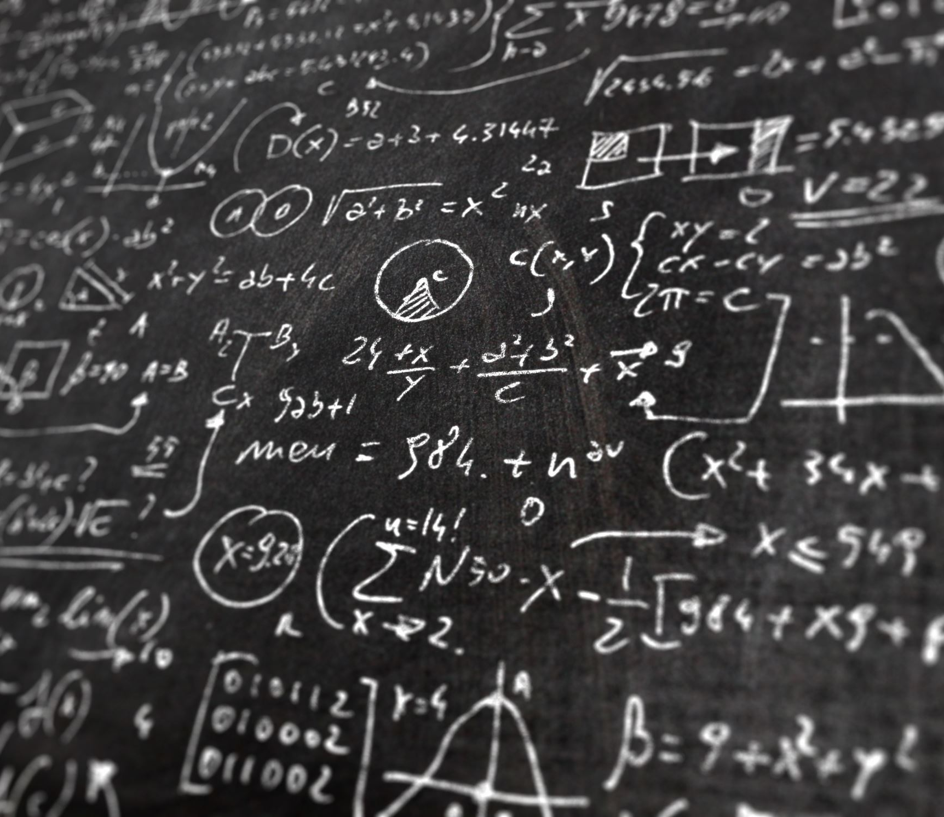
Dr. Jon Harrison Associate Professor of Mathematics jon_harrison@baylor.edu
What is Quantum Chaos?

Slide 2
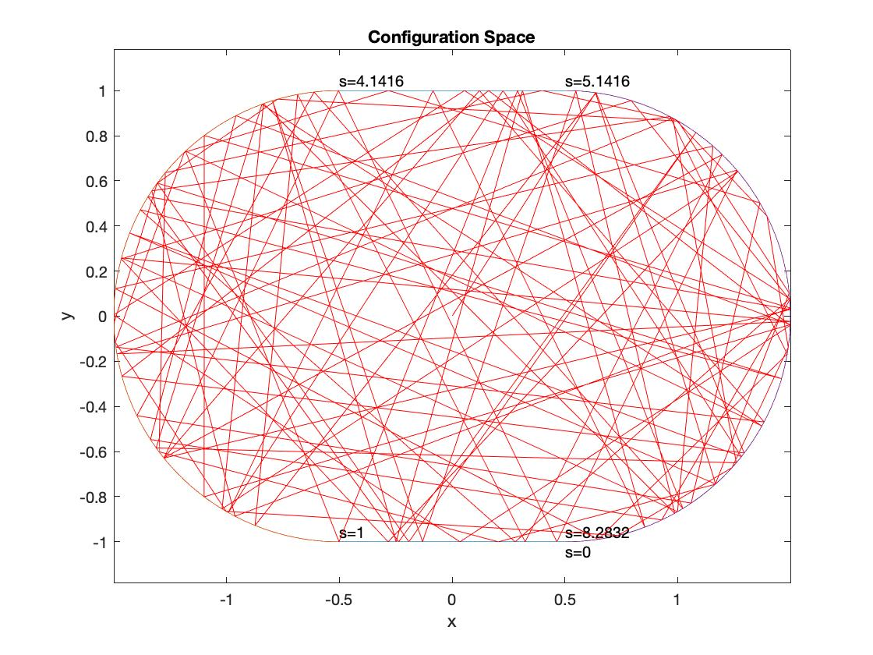
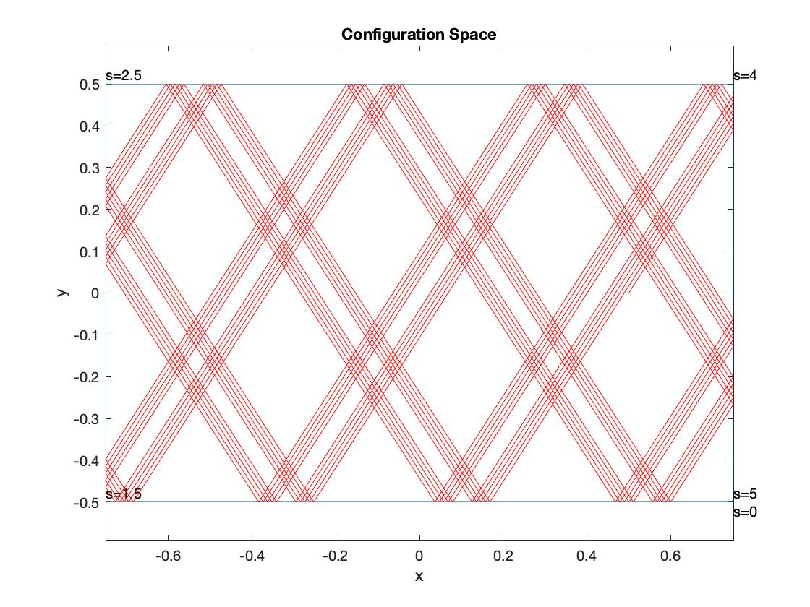
Billiards

Slide 3
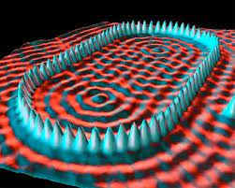
Quantum Billiards
Images: Crommie, Lutz & Eigler at IBM and Arnd Baecker at Dresden

Slide 4
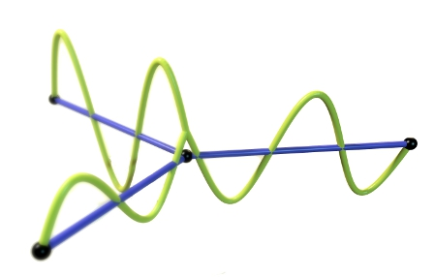
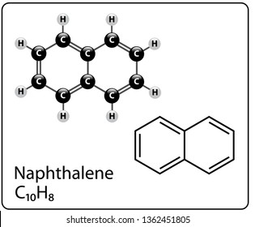
Quantum Graphs

Slide 5
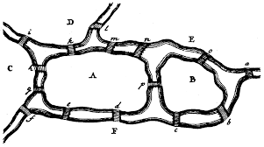
Graphs
Euler 1736
The seven bridges of Konigsburg
Image Paul Butler at Facebook)

Slide 6
Which is the odd one out?
Quantum chaos spectrum
Random matrix spectrum
Random numbers

Slide 7
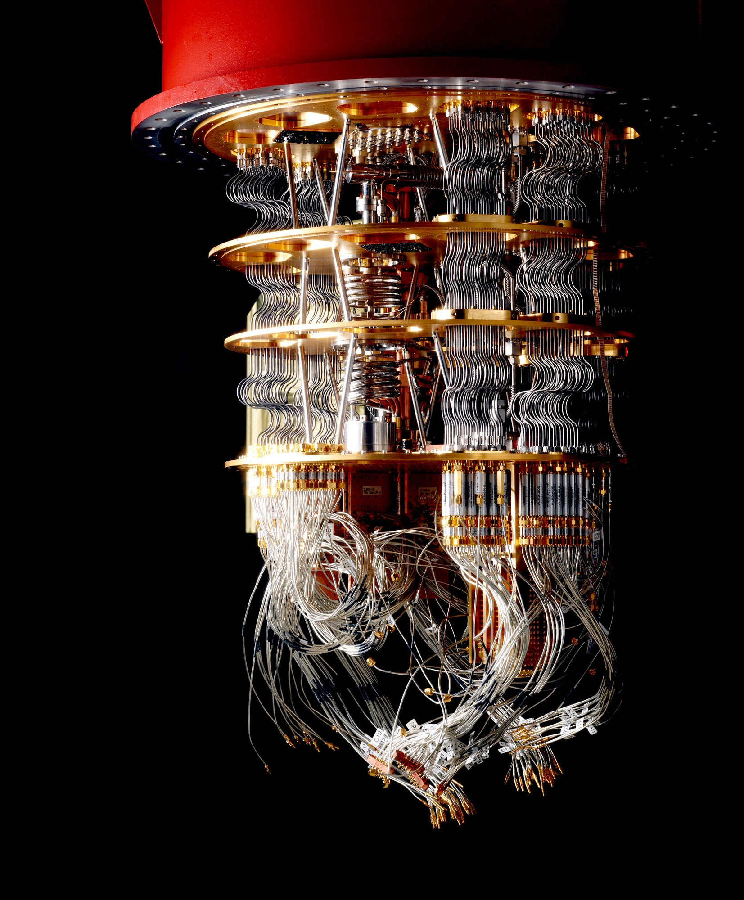
Applications
Internet Security
Quantum Computing
Reimann Hypothesis – Millennium Prize Problem
Image wired

